Slide 1
Corporate English
For Beginner

Slide 2
1.Tips
&
Tricks

Slide 3
Corporate English Improvement
Build Vocabulary
Grammar and Sentence Structure
Email Etiquette
Listening Skills
Speaking Skills
Writing Skills
Presentation Skills
Networking

Slide 4
Build Vocabulary
Writing Effective Emails: Learn terms like "cordially," "regarding," "attached please find," and "for your consideration."
Business Meetings and Discussions: Familiarize yourself with phrases like "in my opinion," "let's move forward," "I'd like to point out," and "to summarize."
Presentation Skills: Master phrases such as "next slide, please," "data analysis reveals," "significant impact," and "highlighting key takeaways."
Negotiations and Deals: Learn terms like "mutually beneficial," "counterproposal," "bottom line," and "terms and conditions." Utilize these phrases during negotiations to communicate your position effectively.
Job Interviews: Master phrases such as "I'm excited about the opportunity," "my strengths include," "relevant experience," and "contributing to the company's success."
Telephone Etiquette: Master phrases such as "May I speak with" and "Could you please hold?" "I'll transfer your call," and "Relay the message."

Slide 5
Grammar and Sentence Structure
Understand Basic Sentence Components: "She (subject) reads (verb) a book (object)."
Study Parts of Speech: Nouns, Verbs, Adjectives, Adverbs, Pronouns, Prepositions, Conjunctions, And Interjections.
Use Simple Sentences: "I like coffee," or "She runs every morning."
Pay Attention to Tenses: "He is reading a book."
Practice Subject-Verb Agreement: "She works," but "They work."
Use Conjunctions and Connectors: “and," "but," and "because," and connectors like "however" and "in addition"
Master Punctuation Rules: commas, periods, question marks, exclamation points, and quotation

Slide 6
Speaking Skills
Focus on Fluency, Not Perfection
Listen and Respond
Speak Slowly and Clearly
Use Common Phrases
Build a Strong Foundation

Slide 7
Listening Skills
Start with Simple Material
Listen Actively
Listen to Various Accents
Break Down Content
Use Language Learning Apps

Slide 8
Writing Skills
Start with Basic Grammar
Practice Frequent Writing
Proofread and Edit
Seek Feedback
Expand Vocabulary
Study Different Writing Styles
Set Writing Goals

Slide 9
Presentation Skills
Understand Your Audience
Structure Your Presentation
Practice Speaking Clearly
Visual Aids
Limit Text on Slides
Practice, Practice, Practice
Time Management
Engage Your Audience
Seek Constructive Feedback

Slide 10
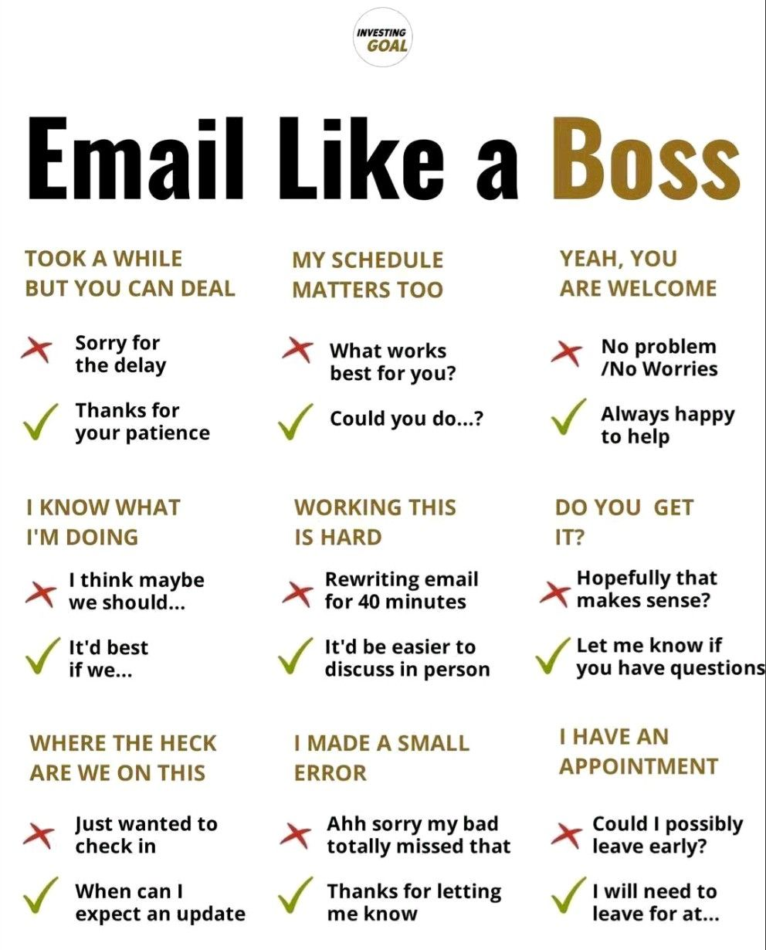
Email Like a BossE

Slide 11
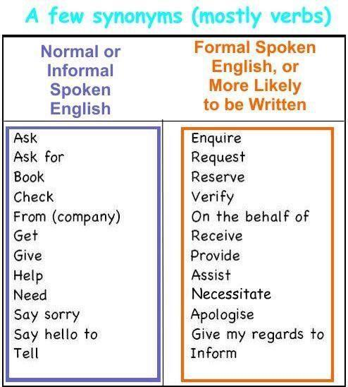
Synonyms

Slide 12
Conversation Starter
How's it going?
What's going on?
What's up?
What's poppin'?
What's crackin'?
What have you been up to?
How have you been?
How are you doing?
How are things?

Slide 13
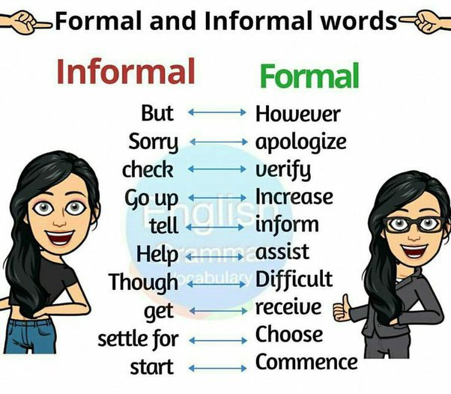
Formal
vs
Informal

Slide 14
Bonus
Tips & Tricks
Cultural awareness
Set Goals
Feedback and Improvement
Consistency

Slide 15

Md. Al Amin
Q&A
Social Media Strategist
Job Placement Team
alamin-munna@programming-hero.com /mdalamin9/

